Slide 1
aeq
Aditya’s expected question

Slide 2
Internal 1

Slide 3
Q1. generate object code
JUST GO THROUGH THESE THREE LINKS ONE BY ONE.
NOTE:- (DON’T SKIP THE VIDEOS GO SLOWLY ONE BY ONE)

Slide 4
How to write an object code for SIC machine? URL:-
https://youtu.be/iO65FNtcxIc

Slide 5
How to write an object code for SIC/XE machine? URL:-
https://www.youtube.com/watch?v=FV5hR7vu8Fs&t=394s

Slide 6
How to write an object code ? URL:-
https://www.youtube.com/watch?v=evVj4dH1ld0&t=47s

Slide 7
Q2. SIC & SIC/XE ARCHITECTURE URL:-
https://www.youtube.com/watch?v=Bv099OLqYks&t=72s

Slide 8
Q3. assembler pass 1 and pass 2 algorithms?

Slide 9
Algorithm for Pass 1

Slide 10
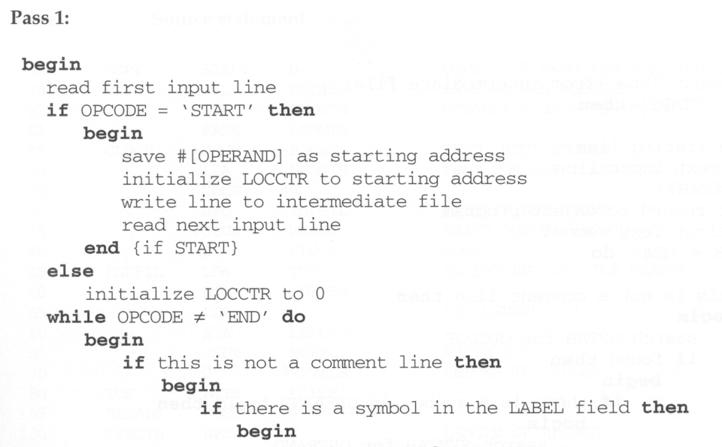
The Pseudo Code for Pass 1

Slide 11
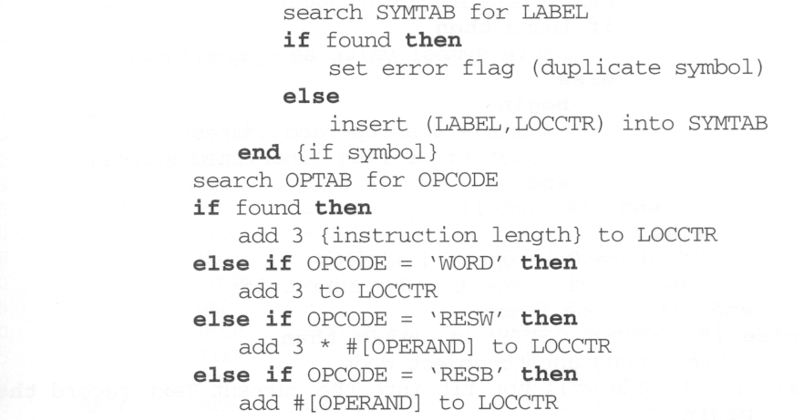

Slide 12
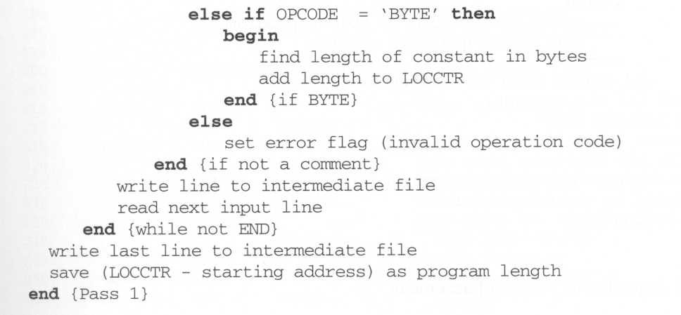

Slide 13
Algorithm for Pass 2

Slide 14
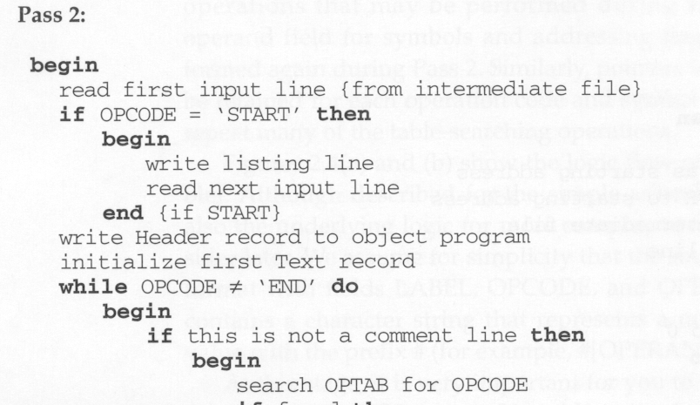
Pseudo Code for Pass 2

Slide 15
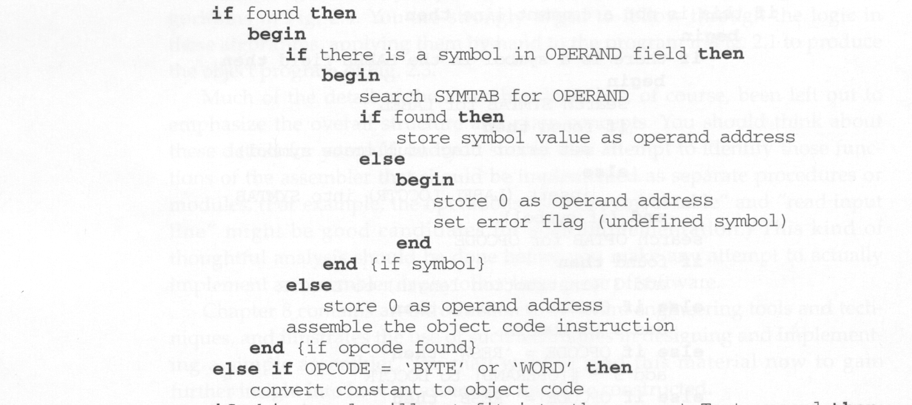
Pseudo Code for Pass 2

Slide 16
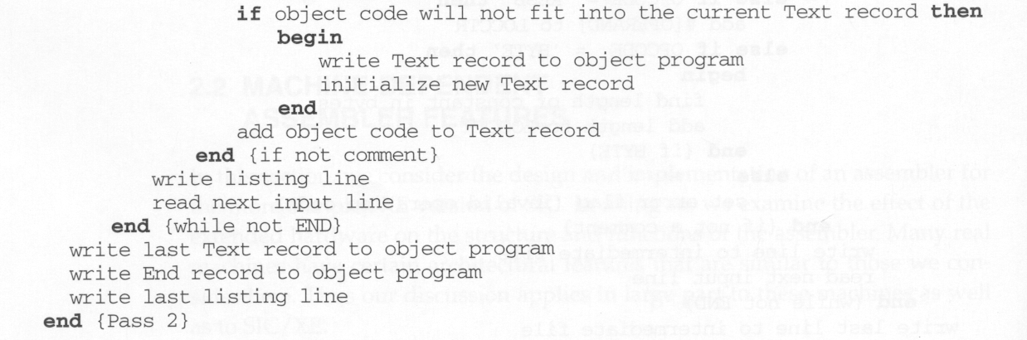
Pseudo Code for Pass 2

Slide 17
Internal 2

Slide 18
Q4. Explain With suitable example explain the following: i) Literals ii) Expressions Symbol Defining statements Define multi pass assembler. Flow forward references are handled by multi pass assembler? illustrate with an example. ?

Slide 19
Q5. Write the algorithm for an absolute loader. What are the advantages of an Absolute loader?

Slide 20
Q6. Write the algorithm for an bootstrap loader. What are the advantages of an bootstrap loader?

Slide 21
Q7. Give a brief note on the assembler directives used in Control Section? illustrate how, to handle external references with multiple control sections in detail with a suitable exam

Slide 22
Internal 3

Slide 23
Q8. algorithm loader pass2?

Slide 24
q9. algorithm macro processor?

Slide 25
Q7. expansion of macro instruction? Example and theory

Slide 26
Q10. dynamic linking?

Slide 27
Q11.conditional macro in.(numerical)?

Slide 28
Q11.refrence problem in loader (numerical)?

Slide 29
compulsory

Slide 30
Q12.architecture and working of editor structure?

Slide 31
Q13.dbms in system software?

Slide 32
thankyou
These are some of the very important and excepted questions in system software.
Don’t take risk too go through all the ppt’s

